Slide 1


Iterative RBFNN-PSO
Ha-Rang Kim
25.8.31
ⓒSaebyeol Yu. Saebyeol’s PowerPoint

Slide 2
Table of contents
1
Iterative RBFNN+PSO

Slide 3
Iterative RBFNN+PSO
-hyperparameter ,parameter optimization /CE optimization
Hyperparameter optimization, Affects parameter optimization,
Store CE value (Hyperparameter selection)

Slide 4
Iterative RBFNN+PSO
Hyperparameter optimization(random)
Compute CE for each fold -> update pbest/gbest (if maller)
Select hyperparameters via PSO
Retrain with new hyperparameters (parameters updated as well)
- FCM/WFCM->LSSVM->softmax->CE

Slide 5
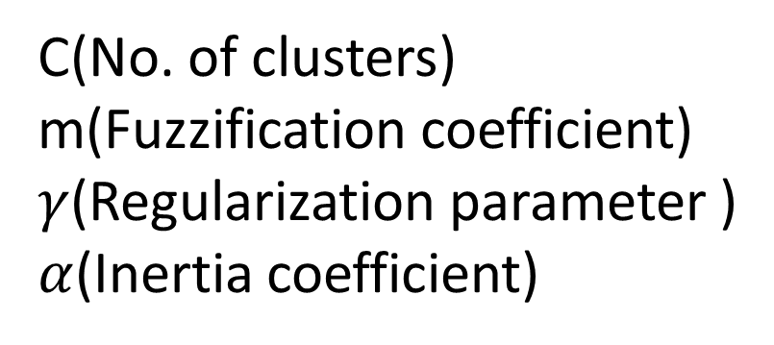
Iterative RBFNN+PSO
C(No. of clusters)
m(Fuzzification coefficient)
$γ$(Regularization parameter )
$α$(Inertia coefficient)
training/validation/test split ratio
1:9 -> 5:4:1

Slide 6
Iterative RBFNN+PSO
Hyperparameter : (γ, c, m, α)
Outer fold = 1:9 (repeat)
Inner 9-fold → split into train/validation (5:4 ratio)
-Combination count: 9C4 = 126
Compute CE values
Outer average = particle’s score
Update pbest/gbest (if current value is smaller → update / if larger → keep)

